Slide 1
Information Ordering
Ling573
Systems & Applications
May 5, 2020

Slide 2
Roadmap
Information ordering
Entity-based cohesion
Motivation
Defining the entity grid
Entity grid for information ordering

Slide 3
Expert-Based Ordering Observations
Nice ideas:
Combining multiple sources of ordering preference
Weight-based integration
Issues:
Sparseness everywhere
Ubiquitous word-level cosine similarity
Probabilistic models
Score handling

Slide 4
Entity-Centric Cohesion
Continuing to talk about same thing(s) lends cohesion to discourse

Slide 5
Entity-Centric Cohesion
Continuing to talk about same thing(s) lends cohesion to discourse
Incorporated variously in discourse models
Lexical chains: Link mentions across sentences
Fewer lexical chains crossing → shift in topic

Slide 6
Entity-Centric Cohesion
Continuing to talk about same thing(s) lends cohesion to discourse
Incorporated variously in discourse models
Lexical chains: Link mentions across sentences
Fewer lexical chains crossing → shift in topic
Salience hierarchies, information structure
Subject > Object > Indirect > Oblique > ….

Slide 7
Entity-Centric Cohesion
Continuing to talk about same thing(s) lends cohesion to discourse
Incorporated variously in discourse models
Lexical chains: Link mentions across sentences
Fewer lexical chains crossing → shift in topic
Salience hierarchies, information structure
Subject > Object > Indirect > Oblique > ….
Centering model of coreference
Combines grammatical role preference with
Preference for types of reference/focus transitions

Slide 8
Entity-Based Ordering
Idea:
Leverage patterns of entity (re)mentions

Slide 9
Entity-Based Ordering
Idea:
Leverage patterns of entity (re)mentions
Intuition:
Captures local relations b/t sentences, entities
Models cohesion of evolving story

Slide 10
Entity-Based Ordering
Idea:
Leverage patterns of entity (re)mentions
Intuition:
Captures local relations b/t sentences, entities
Models cohesion of evolving story
Pros:
Largely delexicalized
Less sensitive to domain/topic than other models
Can exploit state-of-the-art syntax, coreference tools

Slide 11
Entity Grid
Need compact representation of:
Mentions, grammatical roles, transitions
Across sentences
Entity grid model:
Rows:

Slide 12
Entity Grid
Need compact representation of:
Mentions, grammatical roles, transitions
Across sentences
Entity grid model:
Rows: sentences
Columns:

Slide 13
Entity Grid
Need compact representation of:
Mentions, grammatical roles, transitions
Across sentences
Entity grid model:
Rows: sentences
Columns: entities
Values: grammatical role of mention in sentence
Roles: (S)ubject, (O)bject, X (other), __ (no mention)
Multiple mentions: ?

Slide 14
Entity Grid
Need compact representation of:
Mentions, grammatical roles, transitions
Across sentences
Entity grid model:
Rows: sentences
Columns: entities
Values: grammatical role of mention in sentence
Roles: (S)ubject, (O)bject, X (other), __ (no mention)
Multiple mentions: Take highest

Slide 15
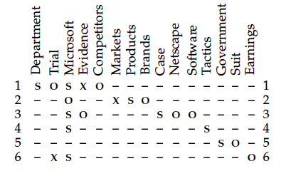
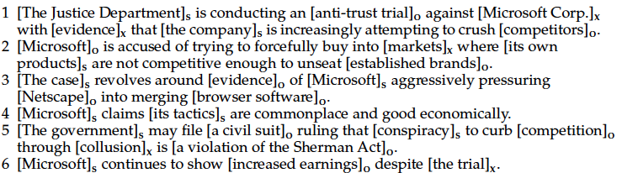

Slide 16
Grids → Features
Intuitions:
Some columns dense: focus of text (e.g. MS)
Likely to take certain roles: e.g. S, O
Others sparse: likely other roles (x)
Local transitions reflect structure, topic shifts

Slide 17
Grids → Features
Intuitions:
Some columns dense: focus of text (e.g. MS)
Likely to take certain roles: e.g. S, O
Others sparse: likely other roles (x)
Local transitions reflect structure, topic shifts
Local entity transitions: {s,o,x,_}^{n}
Continuous column subsequences (role n-grams?)
Compute probability of sequence over grid:
# occurrences of that type/# of occurrences of that len

Slide 18
Vector Representation
Document vector:
Length

Slide 19
Vector Representation
Document vector:
Length: # of transition types
Values:

Slide 20
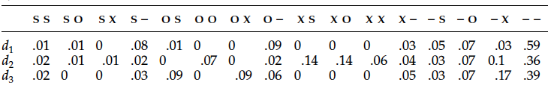
Vector Representation
Document vector:
Length: # of transition types
Values: Probabilities of each transition type
Can vary by transition types:
E.g. most frequent; all transitions of some length, etc

Slide 21
Dependencies & Comparisons
Tools needed:

Slide 22
Dependencies & Comparisons
Tools needed:
Coreference: Link mentions
Full automatic coref system vs

Slide 23
Dependencies & Comparisons
Tools needed:
Coreference: Link mentions
Full automatic coref system vs
Noun clusters based on lexical match
Grammatical role:
Extraction based on dependency parse (+passive rule) vs

Slide 24
Dependencies & Comparisons
Tools needed:
Coreference: Link mentions
Full automatic coref system vs
Noun clusters based on lexical match
Grammatical role:
Extraction based on dependency parse (+passive rule) vs
Simple present vs absent (X, _)

Slide 25
Dependencies & Comparisons
Tools needed:
Coreference: Link mentions
Full automatic coref system vs
Noun clusters based on lexical match
Grammatical role:
Extraction based on dependency parse (+passive rule) vs
Simple present vs absent (X, _)
Salience:
Distinguish focused vs not:?

Slide 26
Dependencies & Comparisons
Tools needed:
Coreference: Link mentions
Full automatic coref system vs
Noun clusters based on lexical match
Grammatical role:
Extraction based on dependency parse (+passive rule) vs
Simple present vs absent (X, _)
Salience:
Distinguish focused vs not:? By frequency
Build different transition models by saliency group

Slide 27
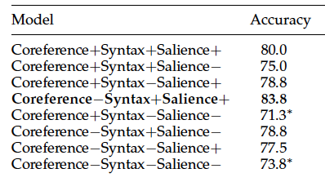
Experiments & Analysis
Trained SVM:
Salient: >= 2 occurrences; Transition length: 2
Train/Test: Is higher manual score set higher by system?
Feature comparison: DUC summaries

Slide 28
Discussion
Best results:
Use richer syntax and salience models
But NOT coreference (though not significant)
Why?

Slide 29
Discussion
Best results:
Use richer syntax and salience models
But NOT coreference (though not significant)
Why? Automatic summaries in training, unreliable coref
Worst results:
Significantly worse with both simple syntax, no salience
Extracted sentences still parse reliably
Still not horrible: 74% vs 84%

Slide 30
Discussion
Best results:
Use richer syntax and salience models
But NOT coreference (though not significant)
Why? Automatic summaries in training, unreliable coref
Worst results:
Significantly worse with both simple syntax, no salience
Extracted sentences still parse reliably
Still not horrible: 74% vs 84%
Much better than LSA model (52.5%)
Learning curve shows 80-100 pairs good enough

Slide 31
State-of-the-Art Comparisons
Two comparison systems:
Latent Semantic Analysis (LSA)
Barzilay & Lee (2004)

Slide 32
Comparison I
LSA model:
Motivation: Lexical gaps

Slide 33
Comparison I
LSA model:
Motivation: Lexical gaps
Pure surface word match misses similarity

Slide 34
Comparison I
LSA model:
Motivation: Lexical gaps
Pure surface word match misses similarity
Discover underlying concept representation
Based on distributional patterns

Slide 35
Comparison I
LSA model:
Motivation: Lexical gaps
Pure surface word match misses similarity
Discover underlying concept representation
Based on distributional patterns
Create term x document matrix over large news corpus

Slide 36
Comparison I
LSA model:
Motivation: Lexical gaps
Pure surface word match misses similarity
Discover underlying concept representation
Based on distributional patterns
Create term x document matrix over large news corpus
Perform SVD to create 100-dimensional dense matrix

Slide 37
Comparison I
LSA model:
Motivation: Lexical gaps
Pure surface word match misses similarity
Discover underlying concept representation
Based on distributional patterns
Create term x document matrix over large news corpus
Perform SVD to create 100-dimensional dense matrix
Score summary as:
Sentence represented as mean of its word vectors
Average of cosine similarity scores of adjacent sents
Local “concept” similarity score

Slide 38
“Catching the Drift”
Barzilay and Lee, 2004 (NAACL best paper)
Intuition:
Stories:
Composed of topics/subtopics
Unfold in systematic sequential way
Can represent ordering as sequence modeling over topics

Slide 39
“Catching the Drift”
Barzilay and Lee, 2004 (NAACL best paper)
Intuition:
Stories:
Composed of topics/subtopics
Unfold in systematic sequential way
Can represent ordering as sequence modeling over topics
Approach: HMM over topics

Slide 40
Strategy
Lightly supervised approach:
Learn topics in unsupervised way from data
Assign sentences to topics

Slide 41
Strategy
Lightly supervised approach:
Learn topics in unsupervised way from data
Assign sentences to topics
Learn sequences from document structure
Given clusters, learn sequence model over them

Slide 42
Strategy
Lightly supervised approach:
Learn topics in unsupervised way from data
Assign sentences to topics
Learn sequences from document structure
Given clusters, learn sequence model over them
No explicit topic labeling, no hand-labeling of sequence

Slide 43
Topic Induction
How can we induce a set of topics from doc set?
Assume we have multiple documents in a domain

Slide 44
Topic Induction
How can we induce a set of topics from doc set?
Assume we have multiple documents in a domain
Unsupervised approach:?

Slide 45
Topic Induction
How can we induce a set of topics from doc set?
Assume we have multiple documents in a domain
Unsupervised approach:? Clustering
Similarity measure?

Slide 46
Topic Induction
How can we induce a set of topics from doc set?
Assume we have multiple documents in a domain
Unsupervised approach:? Clustering
Similarity measure?
Cosine similarity over word bigrams
Assume some irrelevant/off-topic sentences
Merge clusters with few members into “etcetera” cluster

Slide 47
Topic Induction
How can we induce a set of topics from doc set?
Assume we have multiple documents in a domain
Unsupervised approach:? Clustering
Similarity measure?
Cosine similarity over word bigrams
Assume some irrelevant/off-topic sentences
Merge clusters with few members into “etcetera” cluster
Result: m topics, defined by clusters

Slide 48
Sequence Modeling
Hidden Markov Model
States

Slide 49
Sequence Modeling
Hidden Markov Model
States = Topics
State m: special insertion state
Transition probabilities:
Evidence for ordering?

Slide 50
Sequence Modeling
Hidden Markov Model
States = Topics
State m: special insertion state
Transition probabilities:
Evidence for ordering?
Document ordering
Sentence from topic a appears before sentence from topic b

Slide 51
Sequence Modeling
Hidden Markov Model
States = Topics
State m: special insertion state
Transition probabilities:
Evidence for ordering?
Document ordering
Sentence from topic a appears before sentence from topic b

Slide 52
Sequence Modeling II
Emission probabilities:
Standard topic state:
Probability of observation given state (topic)

Slide 53
Sequence Modeling II
Emission probabilities:
Standard topic state:
Probability of observation given state (topic)
Probability of sentence under topic-specific bigram LM
Bigram probabilities

Slide 54
Sequence Modeling II
Emission probabilities:
Standard topic state:
Probability of observation given state (topic)
Probability of sentence under topic-specific bigram LM
Bigram probabilities

Slide 55
Sequence Modeling II
Emission probabilities:
Standard topic state:
Probability of observation given state (topic)
Probability of sentence under topic-specific bigram LM
Bigram probabilities
Etcetera state:
Forced complementary to other states

Slide 56
Sequence Modeling III
Viterbi re-estimation:
Intuition: Refine clusters, etc based on sequence info

Slide 57
Sequence Modeling III
Viterbi re-estimation:
Intuition: Refine clusters, etc based on sequence info
Iterate:
Run Viterbi decoding over original documents
Assign each sentence to cluster most likely to generate it
Use new clustering to recompute transition/emission

Slide 58
Sequence Modeling III
Viterbi re-estimation:
Intuition: Refine clusters, etc based on sequence info
Iterate:
Run Viterbi decoding over original documents
Assign each sentence to cluster most likely to generate it
Use new clustering to recompute transition/emission
Until stable (or fixed iterations)

Slide 59
Sentence Ordering Comparison
Restricted domain text:
Separate collections of earthquake, aviation accidents
LSA predictions:

Slide 60
Sentence Ordering Comparison
Restricted domain text:
Separate collections of earthquake, aviation accidents
LSA predictions: which order has higher score
Topic/content model:

Slide 61
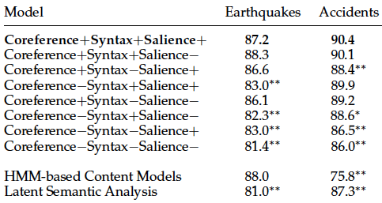
Sentence Ordering Comparison
Restricted domain text:
Separate collections of earthquake, aviation accidents
LSA predictions: which order has higher score
Topic/content model: highest probability under HMM

Slide 62
Summary Coherence Scoring Comparison
Domain independent:
Too little data per domain to estimate topic-content model
Train: 144 pairwise summary rankings
Test: 80 pairwise summary rankings

Slide 63
Summary Coherence Scoring Comparison
Domain independent:
Too little data per domain to estimate topic-content model
Train: 144 pairwise summary rankings
Test: 80 pairwise summary rankings
Entity grid model (best): 83.8%
LSA model: 52.5%
Likely issue:

Slide 64
Summary Coherence Scoring Comparison
Domain independent:
Too little data per domain to estimate topic-content model
Train: 144 pairwise summary rankings
Test: 80 pairwise summary rankings
Entity grid model (best): 83.8%
LSA model: 52.5%
Likely issue:
Bad auto summaries highly repetitive ➔

Slide 65
Summary Coherence Scoring Comparison
Domain independent:
Too little data per domain to estimate topic-content model
Train: 144 pairwise summary rankings
Test: 80 pairwise summary rankings
Entity grid model (best): 83.8%
LSA model: 52.5%
Likely issue:
Bad auto summaries highly repetitive ➔
High inter-sentence similarity

Slide 66
Entity Grid Model
Entity-based cohesion
Creates delexicalized entity sequence representation
Trains ranking procedure based on entity transitions
Recently used to improve discourse cohesion in MT

Slide 67
Neural Sentence Ordering
Strategies:
Local coherence models
Pairwise Ranking (Chen et al, ‘16); Window net (Li,Hovy ‘14)
Hierarchical RNN models
Build paragraph model w/LSTM over word, sentence models
Gong et al, ‘16; Logesawaran et al ’18
“Deep Attentive Sentence Ordering Network”
Combines paragraph models with attention mech

Slide 68
AttOrderNet
Basic approach:
Use LSTMs to build sentence vectors
Use LSTMs+Attention for rep. of paragraphs
Hierarchical representation
Generate ordered sentence output
Evaluated on sentence ordering and pairwise ranking

Slide 69
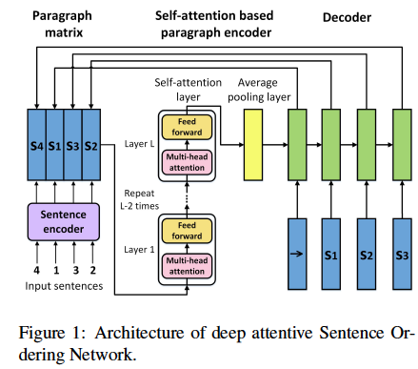
Architecture
Cui et al, ‘18

Slide 70
Problem Structure & Model
Find highest coherence ordering over set of sents:
P(o*|s) > P(o|s), over all possible orderings
Sentence encoding:
Words are represented using pretrained embeddings
100 dim Glove vectors
Vector representation of sentence
Bi-directional LSTM: forward and backward represent’ns
Concatenation of final forward and back hidden states

Slide 71
Paragraph Representation
Sentences are combined into initial matrix E⁰
Sequence of attention, feed-forward layers applied
Computes and weights by relevance scores b/t sents
Computes final vector representation of para
Average over rows of final paragraph matrix
V = 1/nΣ_{i=1:n}e^{Li}

Slide 72
Decoding & Training
Uses LSTM to produce distribution over sentences
Initial state is paragraph representation vector
Input is previous sentence
Training: embedding of true sentence
Testing: embedding of predicted sentence
Performs beam search to order sentences
Training instances?

Slide 73
Decoding & Training
Uses LSTM to produce distribution over sentences
Initial state is paragraph representation vector
Input is previous sentence
Training: embedding of true sentence
Testing: embedding of predicted sentence
Performs beam search to order sentences
Training instances:
Random permutation of document sentences
per epoch

Slide 74
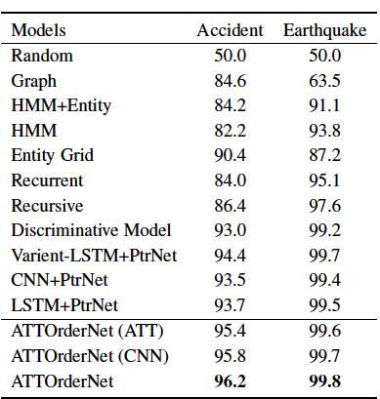
Pairwise Ranking
Task: Rank original clean document higher than permutation

